Slide 1
Cross-Validation and Regularization
LECTURE 16
Different methods for ensuring the generalizability of our models to unseen data.
Sean Kang

Slide 2
Cross Validation

Slide 3
Training vs Test Error
Training error typically under estimates test error.
Underfitting
Overfitting
Best Fit
Test Error
Error
Training Error
Model “complexity”
(e.g., number of features)

Slide 4
Generalization: The Train-Test Split
Training Data: used to fit model
Test Data: check generalization error
How to split?
Randomly, Temporally, Geo…
Depends on application (usually randomly)
What size? (90%-10%)
Larger training set – more complex models
Larger test set – better estimate of generalization error
Typically between 75%-25% and 90%-10%
Train - Test
Split
Train
Data
Test
You can only use the test dataset once after deciding on the model.

Slide 5
Generalization: Validation Split
V
Train - Test
Split
Validation
Split
Train
Train
V
Train
Train
V
Train
Data
V
Train
Validate Generalization
V
5-Fold
Cross Validation
Test
Cross validation simulates multiple train test-splits on the training data.
You can only use the test dataset once after deciding on the model.

Slide 6
Recipe for Successful Generalization
Split your data into training and test sets (90%, 10%)
Use only the training data when designing, training, and tuning the model
Use cross validation to test generalization during this phase
Do not look at the test data
Commit to your final model and train once more using only the training data.
Test the final model using the test data. If accuracy is not acceptable return to (2). (Get more test data if possible.)
Train on all available data and ship it!

Slide 7

Regularization Parametrically Controlling the Model Complexity
𝜆

Slide 8
Basic Idea
We add regularization to a model to reduce the overfitting of a model.
This is a method of adding a penalty to the cost or loss function (RMSE, MSE remember?)
This reduces the magnitude of the coefficient or weight to almost zero.
The penalty can either be L1 or L2 norm.
L1 norm is Lasso
L2 norm is Ridge
This will increase bias but reduce variance

Slide 9
Bias - Variance Trade Off
* Trade off between the error of a complex model versus the error due to the model’s sensitivity to data
High Bias Model – Too simple and cannot capture the patterns of the data.
High Variance Model – Too complex and fits the training data too well thus leads to high variance error on test data
Ideal Model – Low variance and low bias that can handle generic new data.

Slide 10
More about Regularization
It reduces (to almost zero) the coefficients of the irrelevant variables
Side effect – it increases the bias
How to know the level of regularization to use?
Use k-fold cross validation to find the optimal level

Slide 11
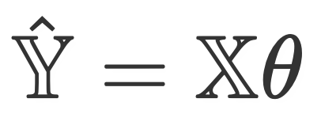
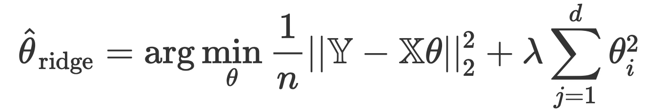
Ridge Regression
“Ridge Regression” is a term for the following specific combination of model, loss, and regularization:
Model:
Loss: Squared loss
Regularization: L2 regularization
The objective function we minimize for Ridge Regression is average squared loss, plus an added penalty:

Slide 12
Ridge Regression
Also called L2 Regression
Adds the square of the coefficients

Slide 13
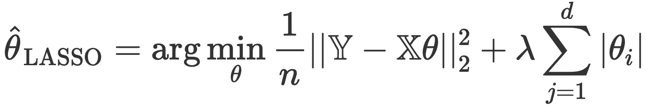
LASSO Regression
“LASSO Regression” is a term for the following specific combination of model, loss, and regularization:
Model:
Loss: Squared loss
Regularization: L1 regularization
The objective function we minimize for LASSO Regression is average squared loss, plus an added penalty:

Slide 14
LASSO Regression
LASSO – Least Absolute Shrinkage Selector Operator
Adds the Sum of the absolute value of the coefficients

Slide 15

Summary of Regression Methods
Name | Model | Loss | Reg. | Objective | Solution
Ridge Regression |  | Squared loss | L2
LASSO |  | Squared loss | L1 |  | No closed form

Slide 16
Fitting vs. Evaluating
While we may use a regularized objective function to determine our model’s parameters, we still look at (root) mean squared error to evaluate our model’s performance.
Which is better? LASSO or Ridge?
They are both similar but LASSO can produce coefficients that are exactly zero which provides better feature selection, in most situations. LASSO works well when there are smaller number of significant parameters, and others are not.

